Slide 1
Architecture Revisions
ARMv7
version
ARM1156T2F-S™
ARM1136JF-S™
ARMv6
ARM1176JZF-S™
ARM102xE
XScaleTM
ARM1026EJ-S™
ARMv5
ARM9x6E
ARM926EJ-S™
SC200™
ARM7TDMI-S™
StrongARM®
ARM92xT
V4
SC100™
ARM720T™
1994
1996
1998
2000
2002
2004
2006
time
XScale is a trademark of Intel Corporation
Notes:
Versions mostly refer to the instruction set that the ARM core executes.
The ARM7, which is still the most often used core in a low-power design, executes the version 4T instruction set. Architectural extensions were added for version 5TE to include DSP instructions, such as 16-bit signed MLA instructions, saturation arithmetic, etc. The ARM926EJ-S and ARM1026EJ-S cores are examples of Version 5 architectures. Version 6 added instructions for doing byte manipulations and graphics algorithms more efficiently. The ARM11 family implemented the Version 6 architecture. Version 7 architectures (which include the Cortex family of cores, such as the Cortex A8, Cortex M3 and Cortex R4) extended the functionality by adding things such as Thumb2, low-power features, and more security.

Slide 2
Data Sizes and Instruction Sets
The ARM is a 32-bit architecture.
When used in relation to the ARM:
Byte means 8 bits
Halfword means 16 bits (two bytes)
Word means 32 bits (four bytes)
Most ARM’s implement two instruction sets
32-bit ARM Instruction Set
16-bit Thumb Instruction Set
Jazelle cores can also execute Java bytecode
Notes:
The cause of confusion here is the term “word” which will mean 16-bits to people with a 16-bit background.
In the ARM world 16-bits is a “halfword” as the architecture is a 32-bit one, whereas “word” means 32-bits.
There are actually three instruction sets in modern ARM cores (such as the version 7 cores – A8, M3, and R4, and even the M1): you have Thumb, Thumb2 and ARM. One core in particular, the M3, executes only Thumb2 code, not ARM. All the instructions are 16 bits.
Java bytecodes are 8-bit instructions designed to be architecture independent. Jazelle transparently executes most bytecodes in hardware and some in highly optimized ARM code. This is due to a tradeoff between hardware complexity (power consumption & silicon area) and speed.

Slide 3
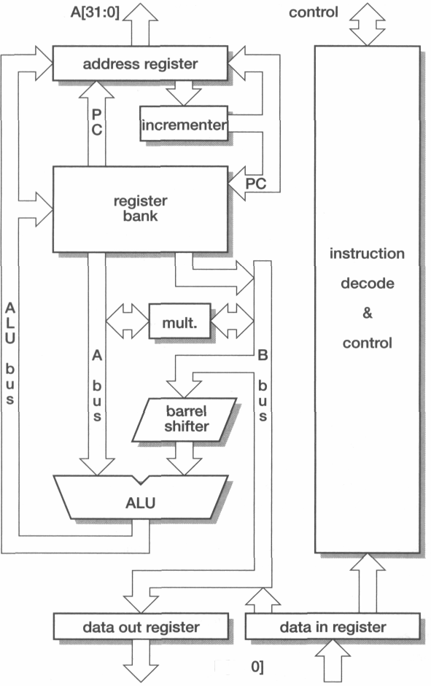

Slide 4
Processor Modes
The ARM has seven basic operating modes:
User : unprivileged mode under which most tasks run
FIQ : entered when a high priority (fast) interrupt is raised
IRQ : entered when a low priority (normal) interrupt is raised
Supervisor : entered on reset and when a Software Interrupt
instruction is executed
Abort : used to handle memory access violations
Undef : used to handle undefined instructions
System : privileged mode using the same registers as user mode

Slide 5
The ARM Register Set
Current Visible Registers
Current Visible Registers
Current Visible Registers
Current Visible Registers
Current Visible Registers
Current Visible Registers
r0
r0
r0
r0
r0
r0
Abort Mode
r0
SVC Mode
Undef Mode
FIQ Mode
User Mode
IRQ Mode
r1
r1
r1
r1
r1
r1
r1
r2
r2
r2
r2
r2
r2
r2
Banked out Registers
Banked out Registers
Banked out Registers
Banked out Registers
Banked out Registers
r3
Banked out Registers
r3
r3
r3
r3
r3
r3
r4
r4
r4
r4
r4
r4
r4
r5
r5
r5
r5
r5
r5
r5
User
User
User
User
User
FIQ
FIQ
FIQ
FIQ
FIQ
FIQ
IRQ
IRQ
IRQ
IRQ
IRQ
IRQ
SVC
SVC
SVC
SVC
SVC
SVC
Undef
Undef
Undef
Undef
Undef
Undef
Abort
Abort
Abort
Abort
Abort
r6
Abort
r6
r6
r6
r6
r6
r6
r7
r7
r7
r7
r7
r7
r7
r8
r8
r8
r8
r8
r8
r8
r8
r8
r8
r8
r8
r8
r8
r9
r9
r9
r9
r9
r9
r9
r9
r9
r9
r9
r9
r9
r9
r10
r10
r10
r10
r10
r10
r10
r10
r10
r10
r10
r10
r10
r10
r11
r11
r11
r11
r11
r11
r11
r11
r11
r11
r11
r11
r11
r11
r12
r12
r12
r12
r12
r12
r12
r12
r12
r12
r12
r12
r12
r12
r13 (sp)
r13 (sp)
r13 (sp)
r13 (sp)
r13 (sp)
r13 (sp)
r13 (sp)
r13 (sp)
r13 (sp)
r13 (sp)
r13 (sp)
r13 (sp)
r13 (sp)
r13 (sp)
r13 (sp)
r13 (sp)
r13 (sp)
r13 (sp)
r13 (sp)
r13 (sp)
r13 (sp)
r13 (sp)
r13 (sp)
r13 (sp)
r13 (sp)
r13 (sp)
r13 (sp)
r13 (sp)
r13 (sp)
r13 (sp)
r13 (sp)
r13 (sp)
r13 (sp)
r13 (sp)
r13 (sp)
r13 (sp)
r13 (sp)
r13 (sp)
r13 (sp)
r13 (sp)
r13 (sp)
r13 (sp)
r14 (lr)
r14 (lr)
r14 (lr)
r14 (lr)
r14 (lr)
r14 (lr)
r14 (lr)
r14 (lr)
r14 (lr)
r14 (lr)
r14 (lr)
r14 (lr)
r14 (lr)
r14 (lr)
r14 (lr)
r14 (lr)
r14 (lr)
r14 (lr)
r14 (lr)
r14 (lr)
r14 (lr)
r14 (lr)
r14 (lr)
r14 (lr)
r14 (lr)
r14 (lr)
r14 (lr)
r14 (lr)
r14 (lr)
r14 (lr)
r14 (lr)
r14 (lr)
r14 (lr)
r14 (lr)
r14 (lr)
r14 (lr)
r14 (lr)
r14 (lr)
r14 (lr)
r14 (lr)
r14 (lr)
r14 (lr)
r15 (pc)
r15 (pc)
r15 (pc)
r15 (pc)
r15 (pc)
r15 (pc)
r15 (pc)
cpsr
cpsr
cpsr
cpsr
cpsr
cpsr
cpsr
spsr
spsr
spsr
spsr
spsr
spsr
spsr
spsr
spsr
spsr
spsr
spsr
spsr
spsr
spsr
spsr
spsr
spsr
spsr
spsr
spsr
spsr
spsr
spsr
spsr
spsr
spsr
spsr
spsr
spsr
spsr
spsr
spsr
spsr
spsr
Notes:
This animated slide shows the way that the banking of registers works. On the left the currently visible set of registers are shown for a particular mode.
On the right are the registers that are banked out whilst in that mode.
Each key press will switch mode:
user -> FIQ ->user -> IRQ -> user ->SVC -> User -> Undef -> User -> Abort and then back to user.
The following slide then shows this in a more static way that is more useful for reference

Slide 6
Exception Handling
When an exception occurs, the ARM:
Copies CPSR into SPSR_<mode>
Sets appropriate CPSR bits
Change to ARM state
Change to exception mode
Disable interrupts (if appropriate)
Stores the return address in LR_<mode>
Sets PC to vector address
To return, exception handler needs to:
Restore CPSR from SPSR_<mode>
Restore PC from LR_<mode>
This can only be done in ARM state.
0x1C
FIQ
0x18
IRQ
0x14
(Reserved)
0x10
Data Abort
0x0C
Prefetch Abort
0x08
Software Interrupt
0x04
Undefined Instruction
0x00
Reset
Vector Table
Vector table can be at 0xFFFF0000 on ARM720T and on ARM9/10 family devices

Slide 7
Program Status Registers
31
28
27
24
23
16
15
8
7
6
5
4
0
N Z C V Q
U n d e f i n e d
I F T mode
J
f
s
x
c
Condition code flags
N = Negative result from ALU
Z = Zero result from ALU
C = ALU operation Carried out
V = ALU operation oVerflowed
Sticky Overflow flag - Q flag
Architecture 5TE/J only
Indicates if saturation has occurred
J bit
Architecture 5TEJ only
J = 1: Processor in Jazelle state
Interrupt Disable bits.
I = 1: Disables the IRQ.
F = 1: Disables the FIQ.
T Bit
Architecture xT only
T = 0: Processor in ARM state
T = 1: Processor in Thumb state
Mode bits
Specify the processor mode
Notes:
Green psr bits are only in certain versions of the ARM architecture
ALU status flags (set if "S" bit set, implied in Thumb state).
Sticky overflow flag (Q flag) is set either when
saturation occurs during QADD, QDADD, QSUB or QDSUB, or
the result of SMLAxy or SMLAWx overflows 32-bits
Once flag has been set can not be modified by one of the above instructions and must write to CPSR using MSR instruction to cleared
PSRs split into four 8-bit fields that can be individually written:
Control (c) bits 0-7
Extension (x) bits 8-15 Reserved for future use
Status (s) bits 16-23 Reserved for future use
Flags (f) bits 24-31
Bits that are reserved for future use should not be modified by current software. Typically, a read-modify-write strategy should be used to update the value of a status register to ensure future compatibility. Note that the T/J bits in the CPSR should never be changed directly by writing to the PSR (use the BX/BXJ instruction to change state instead).
However, in cases where the processor state is known in advance (e.g. on reset, following an interrupt, or some other exception), an immediate value may be written directly into the status registers, to change only specific bits (e.g. to change mode).
New ARM V6 bits now shown.

Slide 8
Program Counter (r15)
When the processor is executing in ARM state:
All instructions are 32 bits wide
All instructions must be word aligned
Therefore the pc value is stored in bits [31:2] with bits [1:0] undefined (as instruction cannot be halfword or byte aligned)
When the processor is executing in Thumb state:
All instructions are 16 bits wide
All instructions must be halfword aligned
Therefore the pc value is stored in bits [31:1] with bit [0] undefined (as instruction cannot be byte aligned)
When the processor is executing in Jazelle state:
All instructions are 8 bits wide
Processor performs a word access to read 4 instructions at once

Slide 9
Conditional Execution and Flags
ARM instructions can be made to execute conditionally by postfixing them with the appropriate condition code field.
This improves code density and performance by reducing the number of forward branch instructions.
CMP r3,#0 CMP r3,#0 BEQ skip ADDNE r0,r1,r2 ADD r0,r1,r2 skip
By default, data processing instructions do not affect the condition code flags but the flags can be optionally set by using “S”. CMP does not need “S”.
loop … SUBS r1,r1,#1 BNE loop
decrement r1 and set flags
if Z flag clear then branch
Notes:
Unusual but powerful feature of the ARM instruction set. Other architectures normally only have conditional branches.
Some recently-added ARM instructions (in v5T and v5TE) are not conditional (e.g. v5T BLX offset)
Core compares condition field in instruction against NZCV flags to determine if instruction should be executed.

Slide 10
Condition Codes
The possible condition codes are listed below
Note AL is the default and does not need to be specified
Suffix
Description
Flags tested
EQ
Equal
Z=1
NE
Not equal
Z=0
CS/HS
Unsigned higher or same
C=1
CC/LO
Unsigned lower
C=0
MI
Minus
N=1
PL
Positive or Zero
N=0
VS
Overflow
V=1
VC
No overflow
V=0
HI
Unsigned higher
C=1 & Z=0
LS
Unsigned lower or same
C=0 or Z=1
GE
Greater or equal
N=V
LT
Less than
N!=V
GT
Greater than
Z=0 & N=V
LE
Less than or equal
Z=1 or N=!V
AL
Always
Notes:
Condition codes are simply a way of testing the ALU status flags.
This slide is for reference only.

Slide 11
Conditional execution examples
C source code
ARM instructions
unconditional
conditional
if (r0 == 0)
{
r1 = r1 + 1;
}
else
{
r2 = r2 + 1;
}
CMP r0, #0
BNE else
ADD r1, r1, #1
B end
else
ADD r2, r2, #1
end
...
CMP r0, #0
ADDEQ r1, r1, #1
ADDNE r2, r2, #1
...
5 instructions
5 words
5 or 6 cycles
3 instructions
3 words
3 cycles

Slide 12
Examples of conditional execution
Use a sequence of several conditional instructions
if (a==0) func(1);
CMP r0,#0 MOVEQ r0,#1 BLEQ func
Set the flags, then use various condition codes
if (a==0) x=0; if (a>0) x=1;
CMP r0,#0 MOVEQ r1,#0 MOVGT r1,#1
Use conditional compare instructions
if (a==4 || a==10) x=0;
CMP r0,#4 CMPNE r0,#10 MOVEQ r1,#0
Notes:
Sequence of conditional instructions:
- no instruction must reset cond code flags
- BL corrupts flags so must be last
- limit sequence to max 3 or so instrs
Can use different condition codes. Give if then else example. Note GCD practical coming later.
Conditional compare
- resets condition code when executed
- compiler will make use of this
- can be difficult for a human to understand!
Not just for compare, using data processing with condition code and S bit is useful in some circumstances.
LDM/LDR instruction cannot set flags due to datapath issues (data comes back only at the very end of the cycle, so there is no opportunity to perform a comparison and set the status flags).

Slide 13
Data Processing Instructions
Consist of :
Arithmetic: ADD ADC SUB SBC RSB RSC
Logical: AND ORR EOR BIC
Comparisons: CMP CMN TST TEQ
Data movement: MOV MVN
These instructions only work on registers, NOT memory.
Syntax:
<Operation>{<cond>}{S} Rd, Rn, Operand2
Comparisons set flags only - they do not specify Rd
Data movement does not specify Rn
Second operand is sent to the ALU via barrel shifter.
Notes:
BIC bit clear
ORR bit set
AND bit mask
EOR bit invert
Comparisons produce no results - just set condition codes.
CMP like SUB
CMN like ADD (subtract of a negative number is the same as add)
TST like AND
TEQ like EOR (eor of identical numbers gives result of zero)
Generally single-cycle execution (except write to PC and register-controlled shift). Mention ARM NOP & Thumb NOP.
Explain RSB and RSC which do subtract in other order (e.g. y-x not x-y)
Does not include multiply (separate instr format). No divide - compiler uses run-time library or barrel shifter to perform division.
Can combine “S” bit with conditional execution, e.g.
ADDEQS r0, r1, r2

Slide 14
The Barrel Shifter
LSL : Logical Left Shift
ASR: Arithmetic Right Shift
CF
Destination
0
Destination
CF
Multiplication by a power of 2
Division by a power of 2, preserving the sign bit
LSR : Logical Shift Right
ROR: Rotate Right
...0
Destination
CF
Destination
CF
Division by a power of 2
Bit rotate with wrap around from LSB to MSB
RRX: Rotate Right Extended
Destination
CF
Single bit rotate with wrap around from CF to MSB
Notes:
Rotate left can be implemented as rotate right (32-number), e.g. rotate left of 10 is performed using rotate right of 22.
RRX shifts by 1 bit position, of a 33 bit amount (includes carry flag). Very specialized application (e.g. encryption algorithms). Cannot be generated by C compiler. We have used it for 64/64 bit divide. RRX allows you to shift multiprecision values right by one efficiently. Also used in ARM’s MPEG code in a very tricky piece of code.
ANSI C does not have a rotate operation (it only has “<<“ and “>>” which are the equivalent of LSL, LSR and ASR). However the ARM compiler recognizes rotate type expresssions and optimizes these to use ROR, e.g.
int f(unsigned int a)
{
return (a << 10) | (a >>22) ;
}
=> MOV a1,a1,ROR #22
Carry flag set out of the shifter for *logical* data processing operations

Slide 15
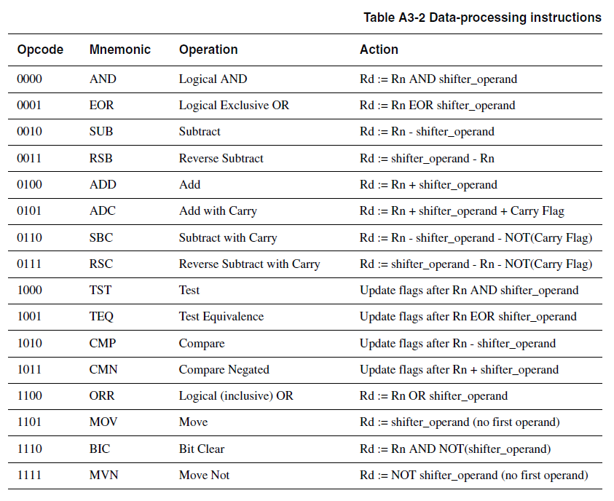
Notes:
BIC bit clear
ORR bit set
AND bit mask
EOR bit invert
Comparisons produce no results - just set condition codes.
CMP like SUB
CMN like ADD (subtract of a negative number is the same as add)
TST like AND
TEQ like EOR (eor of identical numbers gives result of zero)
Generally single-cycle execution (except write to PC and register-controlled shift). Mention ARM NOP & Thumb NOP.
Explain RSB and RSC which do subtract in other order (e.g. y-x not x-y)
Does not include multiply (separate instr format). No divide - compiler uses run-time library or barrel shifter to perform division.
Can combine “S” bit with conditional execution, e.g.
ADDEQS r0, r1, r2

Slide 16
Using a Barrel Shifter:The 2nd Operand
Register, optionally with shift operation
Shift value can be either be:
5 bit unsigned integer
Specified in bottom byte of another register.
Used for multiplication by constant
Immediate value
8 bit number, with a range of 0-255.
Rotated right through even number of positions
Allows increased range of 32-bit constants to be loaded directly into registers
Operand 1
Operand 2
Barrel Shifter
ALU
Result

Slide 17
Data Processing Exercise
1. How would you load the two’s complement representation of -1 into Register 3 using one instruction?
2. Implement an ABS (absolute value) function for a registered value using only two instructions.
3. Multiply a number by 35, guaranteeing that it executes in 2 core clock cycles.

Slide 18
Data Processing Solutions
1. MVN r3, #0
2. MOVS r7,r7 ; set the flags
RSBMI r7,r7,#0 ; if neg, r7=0-r7
3. ADD r9,r8,r8,LSL #2 ; r9=r8*5
RSB r10,r9,r9,LSL #3 ; r10=r9*7

Slide 19
Immediate constants (1)
No ARM instruction can contain a 32 bit immediate constant
All ARM instructions are fixed as 32 bits long
The data processing instruction format has 12 bits available for operand2
4 bit rotate value (0-15) is multiplied by two to give range 0-30 in steps of 2
Rule to remember is “8-bits rotated right by an even number of bit positions”
11
8
7
0
rot
immed_8
Quick Quiz: 0xe3a004ff MOV r0, #???
x2
Shifter ROR

Slide 20
Immediate constants (2)
Examples:
The assembler converts immediate values to the rotate form:
MOV r0,#4096 ; uses 0x40 ror 26
ADD r1,r2,#0xFF0000 ; uses 0xFF ror 16
The bitwise complements can also be formed using MVN:
MOV r0, #0xFFFFFFFF ; assembles to MVN r0,#0
Values that cannot be generated in this way will cause an error.
31
0
ror #0
0
0
0
0
0
0
0
0
0
0
0
0
0
0
0
0
0
0
0
0
0
0
0
0
range 0-0x000000ff step 0x00000001
ror #8
0
0
0
0
0
0
0
0
0
0
0
0
0
0
0
0
0
0
0
0
0
0
0
0
range 0-0xff000000 step 0x01000000
ror #30
0
0
0
0
0
0
0
0
0
0
0
0
0
0
0
0
0
0
0
0
0
0
0
0
range 0-0x000003fc step 0x00000004
Notes:
Point out that it is 8-bit value shifted to anywhere within the 32-bit word (but must be an even number of bits). Other bits are zeros.
Mention that ROR#2,4,6 (not shown) will split the 8-bit immediate with some bits at bottom of word and some at top.
mov r0, #256 ; mov r0, #0x100
mov r1, #0x40, 30 ; mov r1, #0x100
etc.
This method of generating constants allows 3073 distinct values, about 25% fewer than if 12-bits were used without modification. They are, however, a much more useful set of values.

Slide 21
Generating constants
Generate larger constants using move (MOV) and or (ORR):
C Code
int a = 0x7EDC8765;
ARM Assembly Code
# R0 = a
MOV R0, #0x7E000000
ORR R0, R0, #0xDC0000
ORR R0, R0, #0x8700
ORR R0, R0, #0x65
Notes:
Point out that it is 8-bit value shifted to anywhere within the 32-bit word (but must be an even number of bits). Other bits are zeros.
Mention that ROR#2,4,6 (not shown) will split the 8-bit immediate with some bits at bottom of word and some at top.
mov r0, #256 ; mov r0, #0x100
mov r1, #0x40, 30 ; mov r1, #0x100
etc.
This method of generating constants allows 3073 distinct values, about 25% fewer than if 12-bits were used without modification. They are, however, a much more useful set of values.

Slide 22
Loading 32 bit constants
To allow larger constants to be loaded, the assembler offers a pseudo-instruction:
LDR rd, =const
This will either:
Produce a MOV or MVN instruction to generate the value (if possible).
or
Generate a LDR instruction with a PC-relative address to read the constant from a literal pool (Constant data area embedded in the code).
For example
LDR r0,=0xFF => MOV r0,#0xFF
LDR r0,=0x55555555 => LDR r0,[PC,#Imm12] … … DCD 0x55555555
This is the recommended way of loading constants into a register
Notes:
26
Literal pools
These are constant data areas embedded in the code at the end of assembler modules, and at other locations if specified by the user using LTORG. Data value must not be executed (will probably be an undefined instruction), assembly programmer must ensure this by placing LTORG at an appropriate location. ARM C compilers will handle placement of literal pools automatically.

Slide 23
Single register data transfer
LDR STR Word
LDRB STRB Byte
LDRH STRH Halfword
LDRSB Signed byte load
LDRSH Signed halfword load
Memory system must support all access sizes
Syntax:
LDR{<cond>}{<size>} Rd, <address>
STR{<cond>}{<size>} Rd, <address>
e.g. LDREQB
Notes:
Instruction cycle timing:
STR LDR
7TDMI 2 cycles 3 cycles
9TDMI 1 cycle 1 cycle - interlock if used in next cycle
StrongARM1 1 cycle 1 cycle - interlock if used in next cycle
Xscale 1 cycle 1 cycle - interlock if used in next 2 cycles
Note size specifier comes after condition code.
Link: <address> explained on next slide.
Note that load/store instructions never set condition codes.

Slide 24
Address accessed
Address accessed by LDR/STR is specified by a base register with an offset
For word and unsigned byte accesses, offset can be:
An unsigned 12-bit immediate value (i.e. 0 - 4095 bytes) LDR r0, [r1, #8]
A register, optionally shifted by an immediate value LDR r0, [r1, r2] LDR r0, [r1, r2, LSL#2]
This can be either added or subtracted from the base register: LDR r0, [r1, #-8] LDR r0, [r1, -r2, LSL#2]
For halfword and signed halfword / byte, offset can be:
An unsigned 8 bit immediate value (i.e. 0 - 255 bytes)
A register (unshifted)
Choice of pre-indexed or post-indexed addressing
Choice of whether to update the base pointer (pre-indexed only)
LDR r0, [r1, #-8]!
Notes:
Halfword access and signed halfword/byte accesses were added to the architecture in v4T, this is the reason the offset field is not as flexible as the normal word/byte load/store - not a problem because these accesses are less common.
Link: diagram on next slide
No “!” for post-indexed because post-increment of base register always happens (otherwise the offset field would not be used at all).

Slide 25
Pre or Post Indexed Addressing?
Pre-indexed: STR r0,[r1,#12]
Offset
r0
Source Register for STR
12
0x20c
0x5
0x5
r1
Base Register
0x200
0x200
Auto-update form: STR r0,[r1,#12]!
Post-indexed: STR r0,[r1],#12
Updated Base Register
r1
Offset
0x20c
12
0x20c
r0
Source Register for STR
Original Base Register
r1
0x5
0x200
0x5
0x200
Notes:
“!” indicates “writeback” i.e. the base register is to be updated after the instruction.
No “!” for post-indexed because post-increment of base register always happens (otherwise the offset field would not be used at all).
Give C example:
int *ptr;
x = *ptr++;
Compiles to a single instruction:
LDR r0, [r1], #4

Slide 26
C language example
int *ptr;
int x, y;
ptr = &y;
x = *ptr++;
Compiles to a single instruction:
LDR r0,[r1],#4

Slide 27
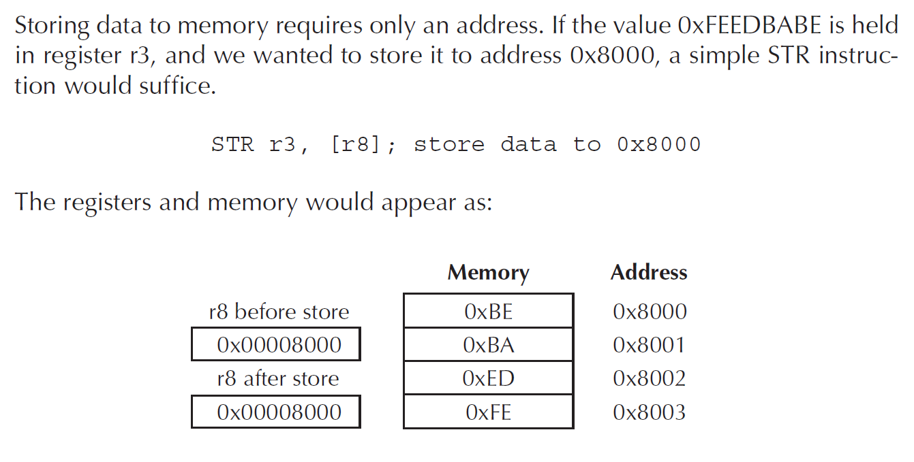
Single register data transfer

Slide 28
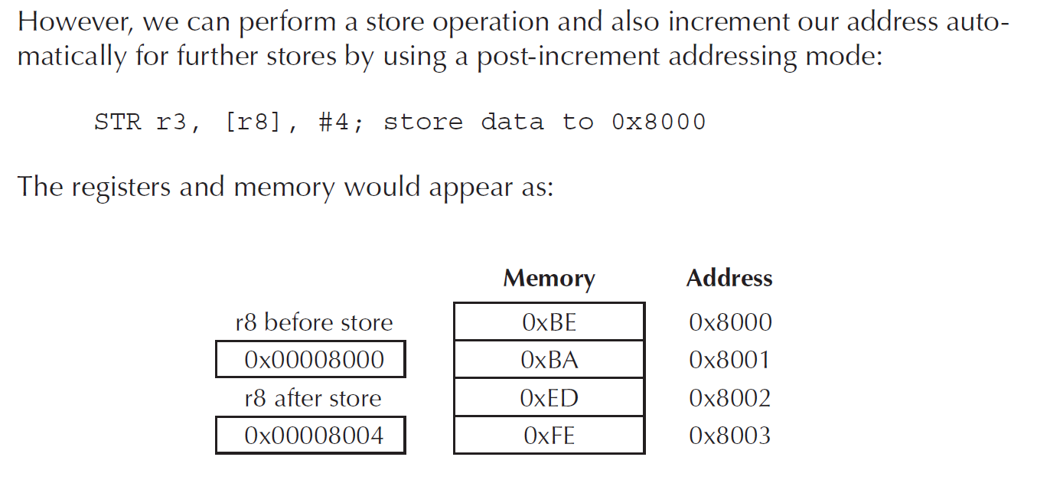
Single register data transfer

Slide 29
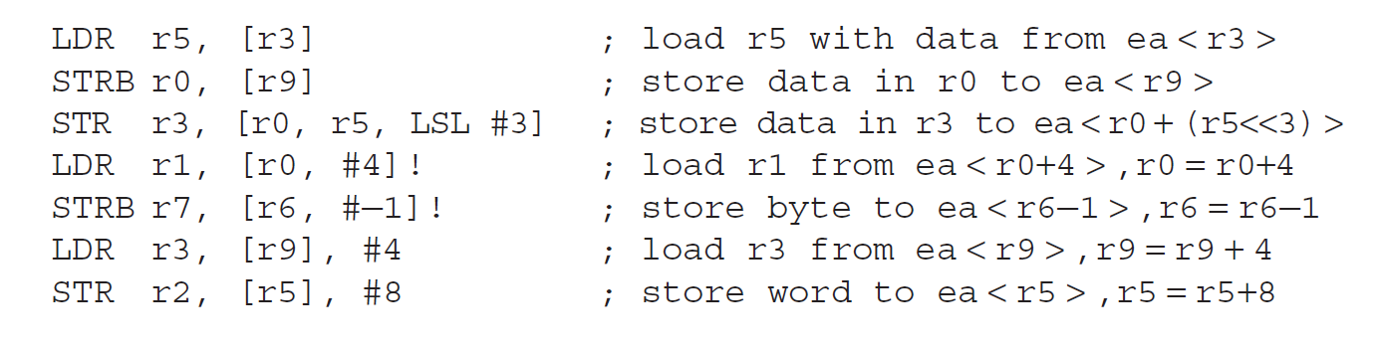
Single register data transfer: examples

Slide 30
Load/Store Exercise
Assume an array of 25 words. A compiler associates y with r1. Assume that the base address for the array is located in r2. Translate this C statement/assignment using just three instructions:
array[10] = array[5] + y;

Slide 31
Load/Store Exercise Solution
array[10] = array[5] + y;
LDR r3, [r2, #20] ; r3 = array[5]
ADD r3, r3, r1 ; r3 = array[5] + y
STR r3, [r2, #40] ; array[5] + y = array[10]

Slide 32
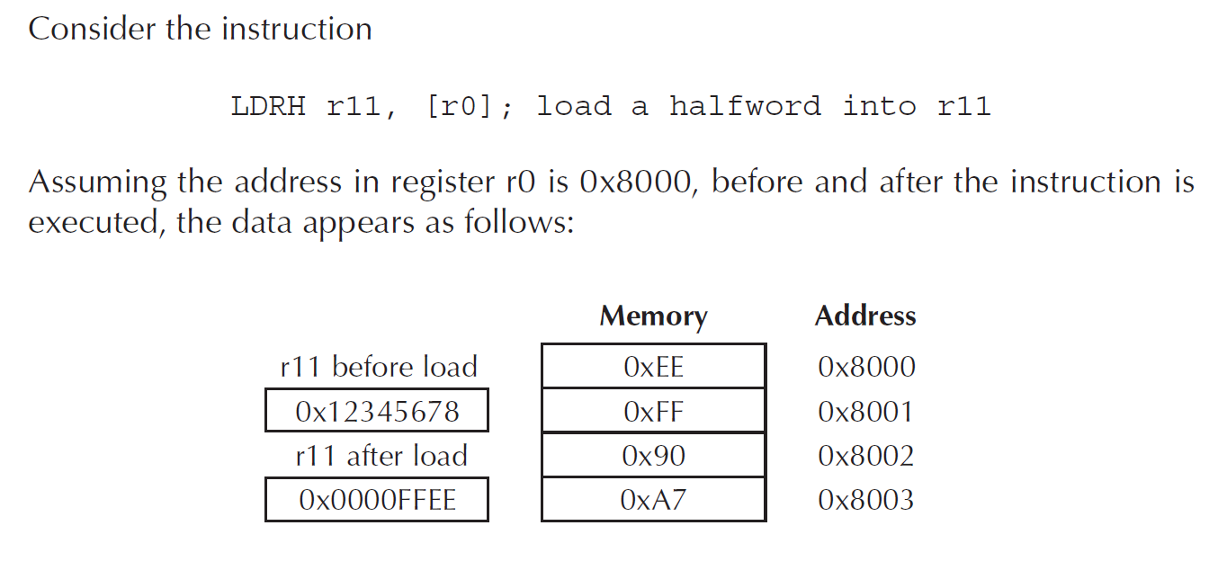
Load/Store halfword

Slide 33
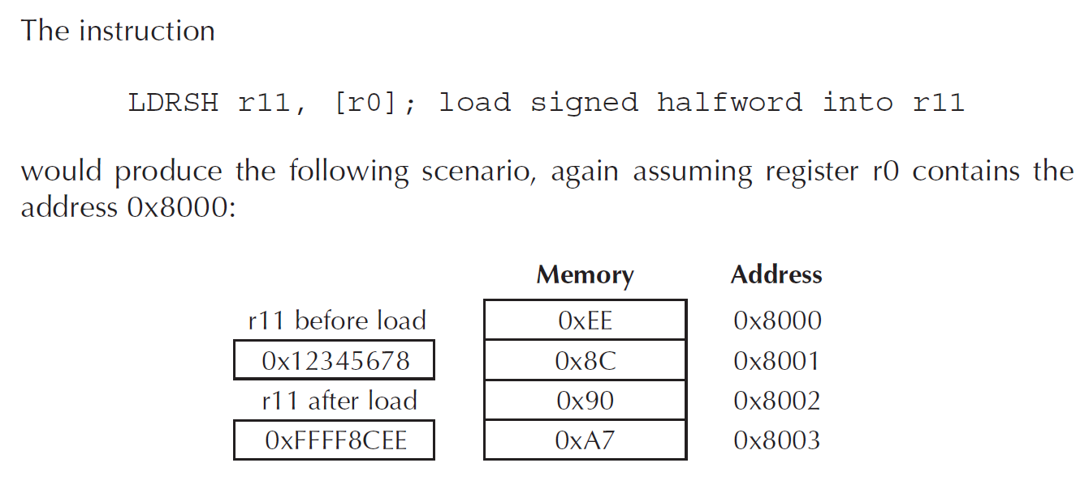
Load/Store signed halfword

Slide 34
Load and Store Multiples
Syntax:
<LDM|STM>{<cond>}<addressing_mode> Rb{!}, <register list>
4 addressing modes:
LDMIA / STMIA increment after
LDMIB / STMIB increment before
LDMDA / STMDA decrement after
LDMDB / STMDB decrement before
IA
IB
DA
DB
LDMxx r10, {r0,r1,r4}
STMxx r10, {r0,r1,r4}
r4
r4
r1
r1
r0
Increasing Address
Base Register (Rb)
r10
r0
r4
r1
r4
r0
r1
r0
Notes:
Several aliases for stack usage are allowed for instance:
LDMFD -> LDMIA
STDFD -> STMDB

Slide 35
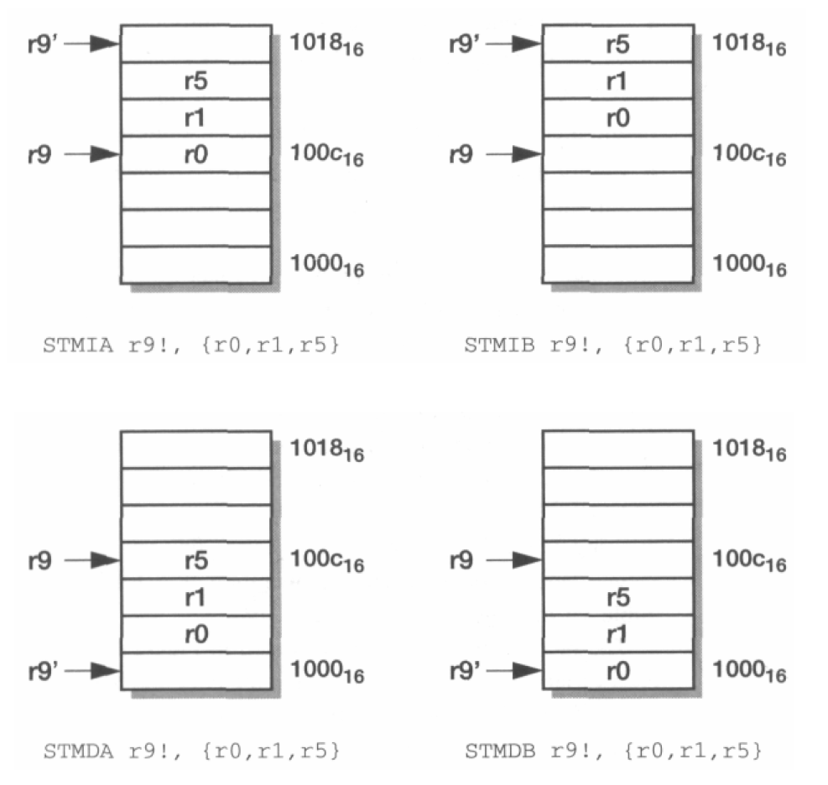
Load and Store Multiples
Notes:
Several aliases for stack usage are allowed for instance:
LDMFD -> LDMIA
STDFD -> STMDB

Slide 36
Multiply and Divide
There are 2 classes of multiply - producing 32-bit and 64-bit results
32-bit versions on an ARM7TDMI will execute in 2 - 5 cycles
MUL r0, r1, r2 ; r0 = r1 * r2
MLA r0, r1, r2, r3 ; r0 = (r1 * r2) + r3
64-bit multiply instructions offer both signed and unsigned versions
For these instruction there are 2 destination registers
[U|S]MULL r4, r5, r2, r3 ; r5:r4 = r2 * r3
[U|S]MLAL r4, r5, r2, r3 ; r5:r4 = (r2 * r3) + r5:r4
Most ARM cores do not offer integer divide instructions
Division operations will be performed by C library routines or inline shifts
Notes:
We have two basic types of multiply instructions; those that produce a 32 bit result based on the bottom 32 bits of a 64-bit result, and those that produce the full 64 bit result. Now, for each of those, we can do accumulation or not. We do have signed and unsigned versions of the MUL long instructions. And if we are only using the bottom 32 bits of a 64 bit result for the standard MULS, then there is no reason to have signed versions.
ARM7TDMI and ARM9TDMI use 8-bit Booth’s algorithm, which takes 1 cycle for each byte in Rs and terminates when rest of Rs is all zeros or all ones. Most of the cores have early termination based on contents of operand 2. Therefore smaller value if known should be placed in operand 2 if possible. And as you can see from the examples, there is not support for the use of immediates.
Cycle information is general and specific cores. You should refer to a core’s particular TRM for timing information.
The Cortex-M3 does have hardware divide.

Slide 37
Branch instructions
Branch : B{<cond>} label
Branch with Link : BL{<cond>} subroutine_label
The processor core shifts the offset field left by 2 positions, sign-extends it and adds it to the PC
± 32 Mbyte range
How to perform longer branches?
31
28
27
25
24
23
0
Cond 1 0 1 L Offset
Link bit 0 = Branch
1 = Branch with link
Condition field
MOV LR, PC
LDR PC,=dest
Notes:
PC-relative to allow position independent code, and allows restricted branch range to jump to nearby addresses.
How to access full 32-bit address space? Can set up LR manually if needed, then load into PC
MOV lr, pc
LDR pc, =dest
ADS linker will automatically generate long branch veneers for branches beyond 32Mb range.

Slide 38
Register Usage
Register
The compiler has a set of rules known as a Procedure Call Standard that determine how to pass parameters to a function (see AAPCS)
CPSR flags may be corrupted by function call.
Assembler code which links with compiled code must follow the AAPCS at external interfaces
The AAPCS is part of the new ABI for the ARM Architecture
Arguments into function
Result(s) from function
otherwise corruptible
(Additional parameters
passed on stack)
r0
r1
r2
r3
r4
r5
r6
Register variables
Must be preserved
r7
r8
r9/sb
- Stack base
r10/sl
- Stack limit if software stack checking selected
r11
Scratch register
(corruptible)
r12
Stack Pointer Link Register
Program Counter
r13/sp
- SP should always be 8-byte (2 word) aligned
r14/lr
- R14 can be used as a temporary once value stacked
r15/pc
Notes:
The compiler has a set of rules that determines a standard for passing parameters between functions. This is know as the ARM Architecture Procedure Call Standard. The AAPCS defines how functions behave from the processors point of view, defining things such as which registers can be corrupted by a function call (r0-r3, and r12), and which registers are non-corruptible over function calls (in other words, registers that must be preserved over function calls). Those would be registers r4 – r11.
If we are using software stack checking, the compiler would use r9 as a stack base and r10 as a stack limit. Stacks grow unchecked by default. With SWSC, either the C library checks that the stack does not override the heap, or the stack is checked against the stack limit. This just depends on the image memory model. And of course as we’ve seen, r13, 14, and 15 are used as the sp, lr, an pc, respectively.
The Application Binary Interface (ABI) for the ARM® Architecture is a collection of all of the standards used in the ARM architecture, some open and some specific to the ARM, anything from the executable image file standards produced by development tools to exception handling standards, to the AMBA spec. You can view the full ARM ABI on our webpages.

Slide 39
Input Arguments and Return Value
C Code
int main()
{
int y;
...
y = diffofsums(2, 3, 4, 5); // 4 arguments
...
}
int diffofsums(int f, int g, int h, int i)
{
int result;
result = (f + g) - (h + i);
return result; // return value
}
Notes:
The compiler has a set of rules that determines a standard for passing parameters between functions. This is know as the ARM Architecture Procedure Call Standard. The AAPCS defines how functions behave from the processors point of view, defining things such as which registers can be corrupted by a function call (r0-r3, and r12), and which registers are non-corruptible over function calls (in other words, registers that must be preserved over function calls). Those would be registers r4 – r11.
If we are using software stack checking, the compiler would use r9 as a stack base and r10 as a stack limit. Stacks grow unchecked by default. With SWSC, either the C library checks that the stack does not override the heap, or the stack is checked against the stack limit. This just depends on the image memory model. And of course as we’ve seen, r13, 14, and 15 are used as the sp, lr, an pc, respectively.
The Application Binary Interface (ABI) for the ARM® Architecture is a collection of all of the standards used in the ARM architecture, some open and some specific to the ARM, anything from the executable image file standards produced by development tools to exception handling standards, to the AMBA spec. You can view the full ARM ABI on our webpages.

Slide 40
Input Arguments and Return Value
ARM Assembly Code
; R4 = y
MAIN
...
MOV R0, #2 ; argument 0 = 2
MOV R1, #3 ; argument 1 = 3
MOV R2, #4 ; argument 2 = 4
MOV R3, #5 ; argument 3 = 5
BL DIFFOFSUMS ; call function
MOV R4, R0 ; y = returned value
...
; R4 = result
DIFFOFSUMS
ADD R8, R0, R1 ; R8 = f + g
ADD R9, R2, R3 ; R9 = h + i
SUB R4, R8, R9 ; result = (f + g) - (h + i)
MOV R0, R4 ; put return value in R0
MOV PC, LR ; return to caller
Notes:
The compiler has a set of rules that determines a standard for passing parameters between functions. This is know as the ARM Architecture Procedure Call Standard. The AAPCS defines how functions behave from the processors point of view, defining things such as which registers can be corrupted by a function call (r0-r3, and r12), and which registers are non-corruptible over function calls (in other words, registers that must be preserved over function calls). Those would be registers r4 – r11.
If we are using software stack checking, the compiler would use r9 as a stack base and r10 as a stack limit. Stacks grow unchecked by default. With SWSC, either the C library checks that the stack does not override the heap, or the stack is checked against the stack limit. This just depends on the image memory model. And of course as we’ve seen, r13, 14, and 15 are used as the sp, lr, an pc, respectively.
The Application Binary Interface (ABI) for the ARM® Architecture is a collection of all of the standards used in the ARM architecture, some open and some specific to the ARM, anything from the executable image file standards produced by development tools to exception handling standards, to the AMBA spec. You can view the full ARM ABI on our webpages.

Slide 41
Storing Register Values on the Stack
ARM Assembly Code
; R2 = result
DIFFOFSUMS
SUB SP, SP, #12 ; make space on stack for 3 registers
STR R9, [SP, #8] ; save R9 on stack
STR R8, [SP, #4] ; save R8 on stack
STR R4, [SP] ; save R4 on stack
ADD R8, R0, R1 ; R8 = f + g
ADD R9, R2, R3 ; R9 = h + i
SUB R4, R8, R9 ; result = (f + g) - (h + i)
MOV R0, R4 ; put return value in R0
LDR R4, [SP] ; restore R4 from stack
LDR R8, [SP, #4] ; restore R8 from stack
LDR R9, [SP, #8] ; restore R9 from stack
ADD SP, SP, #12 ; deallocate stack space
MOV PC, LR ; return to caller
Notes:
The compiler has a set of rules that determines a standard for passing parameters between functions. This is know as the ARM Architecture Procedure Call Standard. The AAPCS defines how functions behave from the processors point of view, defining things such as which registers can be corrupted by a function call (r0-r3, and r12), and which registers are non-corruptible over function calls (in other words, registers that must be preserved over function calls). Those would be registers r4 – r11.
If we are using software stack checking, the compiler would use r9 as a stack base and r10 as a stack limit. Stacks grow unchecked by default. With SWSC, either the C library checks that the stack does not override the heap, or the stack is checked against the stack limit. This just depends on the image memory model. And of course as we’ve seen, r13, 14, and 15 are used as the sp, lr, an pc, respectively.
The Application Binary Interface (ABI) for the ARM® Architecture is a collection of all of the standards used in the ARM architecture, some open and some specific to the ARM, anything from the executable image file standards produced by development tools to exception handling standards, to the AMBA spec. You can view the full ARM ABI on our webpages.

Slide 42
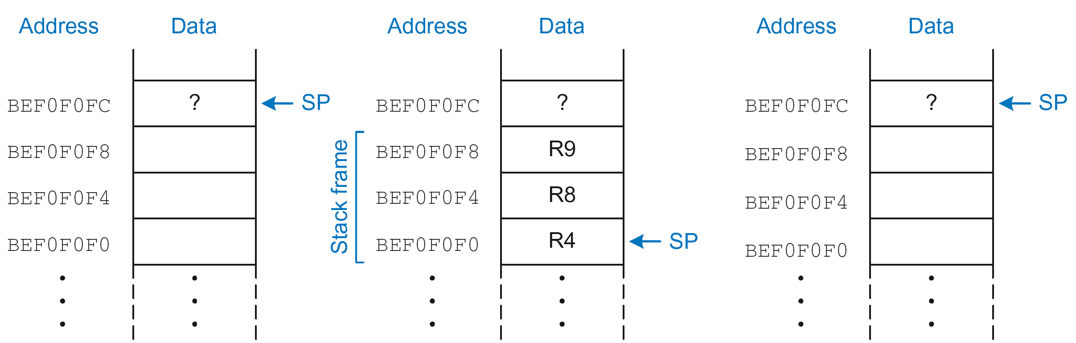
The Stack during diffofsums Call
Before call
During call
After call
Notes:
The compiler has a set of rules that determines a standard for passing parameters between functions. This is know as the ARM Architecture Procedure Call Standard. The AAPCS defines how functions behave from the processors point of view, defining things such as which registers can be corrupted by a function call (r0-r3, and r12), and which registers are non-corruptible over function calls (in other words, registers that must be preserved over function calls). Those would be registers r4 – r11.
If we are using software stack checking, the compiler would use r9 as a stack base and r10 as a stack limit. Stacks grow unchecked by default. With SWSC, either the C library checks that the stack does not override the heap, or the stack is checked against the stack limit. This just depends on the image memory model. And of course as we’ve seen, r13, 14, and 15 are used as the sp, lr, an pc, respectively.
The Application Binary Interface (ABI) for the ARM® Architecture is a collection of all of the standards used in the ARM architecture, some open and some specific to the ARM, anything from the executable image file standards produced by development tools to exception handling standards, to the AMBA spec. You can view the full ARM ABI on our webpages.

Slide 43
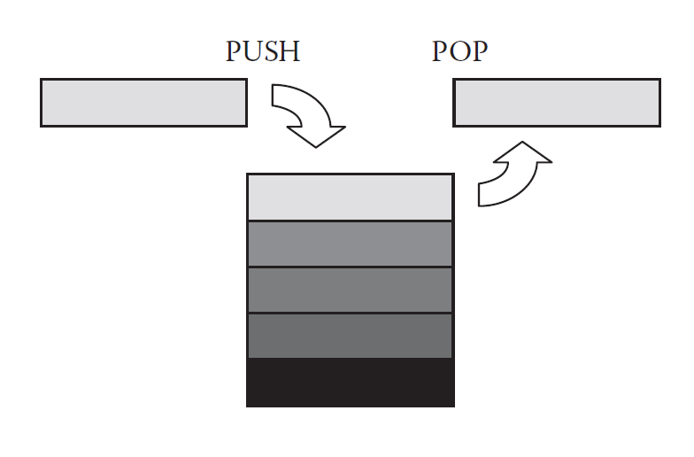
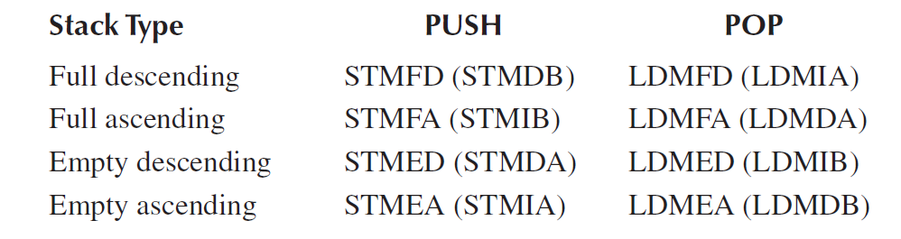
A hardware stack in memory

Slide 44
SAVING AND RESTORING MULTIPLE REGISTERS
ARM Assembly Code
; R4 = result
DIFFOFSUMS
STMFD SP!, {R4, R8, R9} ; push R4/8/9 on full descending stack
ADD R8, R0, R1 ; R8 = f + g
ADD R9, R2, R3 ; R9 = h + i
SUB R4, R8, R9 ; result = (f + g) − (h + i)
MOV R0, R4 ; put return value in R0
LDMFD SP!, {R4, R8, R9} ; pop R4/8/9 off full descending stack
MOV PC, LR ; return to caller
STMFD -> STMDB
PUSH
LDMFD -> LDMIA
POP
PUSH (and POP) save (and restore) registers on the stack in order of register number from low to high, with the lowest numbered register placed at the lowest memory address
Notes:
The compiler has a set of rules that determines a standard for passing parameters between functions. This is know as the ARM Architecture Procedure Call Standard. The AAPCS defines how functions behave from the processors point of view, defining things such as which registers can be corrupted by a function call (r0-r3, and r12), and which registers are non-corruptible over function calls (in other words, registers that must be preserved over function calls). Those would be registers r4 – r11.
If we are using software stack checking, the compiler would use r9 as a stack base and r10 as a stack limit. Stacks grow unchecked by default. With SWSC, either the C library checks that the stack does not override the heap, or the stack is checked against the stack limit. This just depends on the image memory model. And of course as we’ve seen, r13, 14, and 15 are used as the sp, lr, an pc, respectively.
The Application Binary Interface (ABI) for the ARM® Architecture is a collection of all of the standards used in the ARM architecture, some open and some specific to the ARM, anything from the executable image file standards produced by development tools to exception handling standards, to the AMBA spec. You can view the full ARM ABI on our webpages.

Slide 45
ARM Branches and Subroutines
B <label>
PC relative. ±32 Mbyte range.
BL <subroutine>
Stores return address in LR
Returning implemented by restoring the PC from LR
For non-leaf functions, LR will have to be stacked
nonleaf function
leaf function
func1
func2
:
:
BL func1
:
:
STMFD sp!,{regs,lr}
:
BL func2
:
LDMFD sp!,{regs,pc}
:
:
:
:
:
MOV pc, lr
Notes:
This slide shows the way that ARM branch instructions work
It also shows the need to stack the LR (using STM/LDM instructions) when making subroutine calls within subroutines.

Slide 46
Nonleaf Function Example
ARM Assembly Code
; R0=a, R1=b, R4=i, R5=x
F1
PUSH {R4, R5, LR}
ADD R5, R0, R1
SUB R12, R0, R1
MUL R5, R5, R12
MOV R4, #0
FOR
CMP R4, R0
BGE RETURN
PUSH {R0, R1}
ADD R0, R1, R4
BL F2
ADD R5, R5, R0
POP {R0, R1}
ADD R4, R4, #1
B FOR
RETURN
MOV R0, R5
POP {R4, R5, LR}
MOV PC, LR
C Code
int f1(int a, int b) {
int i, x;
x = (a + b)*(a − b);
for (i=0; i<a; i++)
x = x + f2(b+i);
return x;
}
int f2(int p) {
int r;
r = p + 5;
return r + p;
}
; R0=p, R4=r
F2
PUSH {R4}
ADD R4, R0,#5
ADD R0, R4, R0
POP {R4}
MOV PC, LR
PC
Notes:
This slide shows the way that ARM branch instructions work
It also shows the need to stack the LR (using STM/LDM instructions) when making subroutine calls within subroutines.

Slide 47
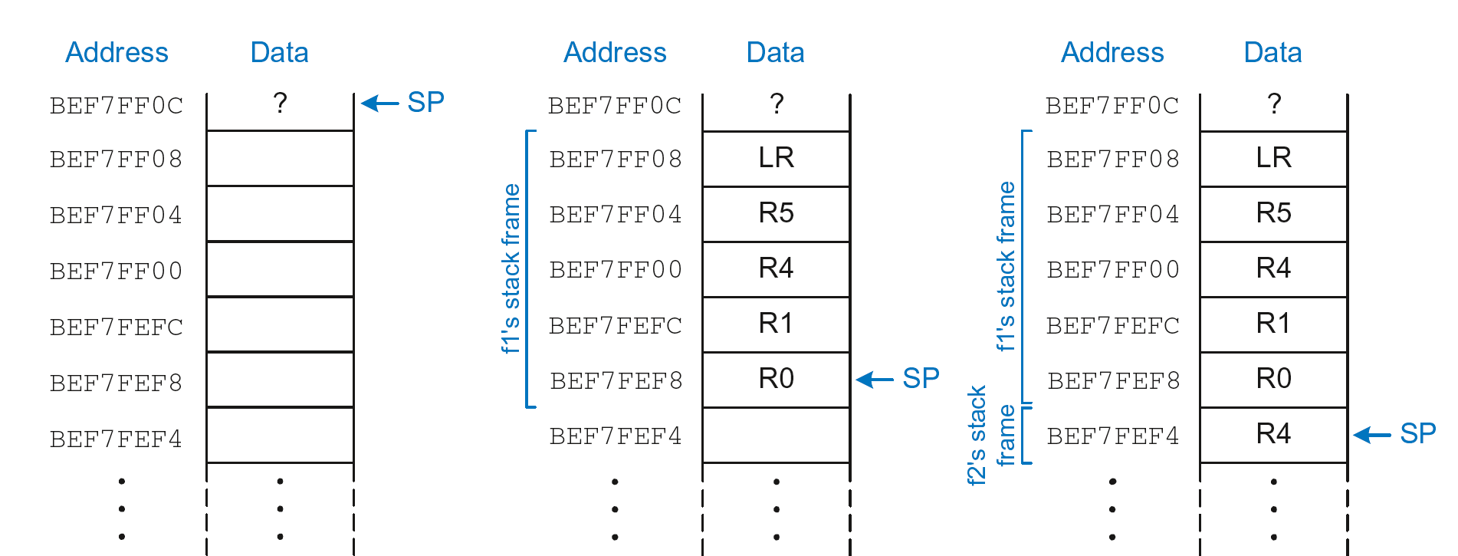
Stack during Nonleaf Function
Notes:
This slide shows the way that ARM branch instructions work
It also shows the need to stack the LR (using STM/LDM instructions) when making subroutine calls within subroutines.

Slide 48
Recursive Function Call
C Code
int factorial(int n) {
if (n <= 1)
return 1;
else
return (n * factorial(n-1));
}
ARM Assembly Code
0x8500 FACTORIAL PUSH {R0,LR}
0x8504 CMP R0, #1
0x8508 BGT ELSE
0x850C MOV R0, #1
0x8510 ADD SP, SP, #8
0x8514 MOV PC, LR
0x8518 ELSE SUB R0, R0, #1
0x851C BL FACTORIAL
0x8520 POP {R1, LR}
0x8524 MUL R0, R1, R0
0x8528 MOV PC, LR
Notes:
This slide shows the way that ARM branch instructions work
It also shows the need to stack the LR (using STM/LDM instructions) when making subroutine calls within subroutines.

Slide 49
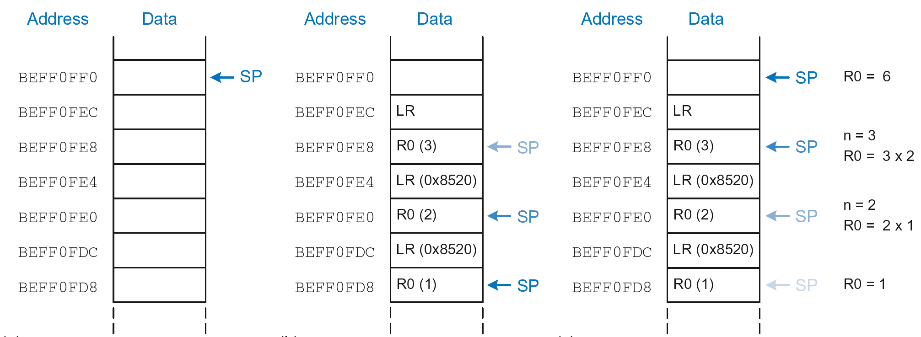
Stack during Recursive Call
Notes:
This slide shows the way that ARM branch instructions work
It also shows the need to stack the LR (using STM/LDM instructions) when making subroutine calls within subroutines.

Slide 50
Additional Arguments and Local Variables
Stack usage: (a) before and (b) after call
Notes:
Accessing additional input arguments is the one exception in which a function can access stack data not in its own stack frame.

Slide 51
PSR access
MRS and MSR allow contents of CPSR / SPSR to be transferred to / from a general purpose register or take an immediate value
MSR allows the whole status register, or just parts of it to be updated
Interrupts can be enable/disabled and modes changed, by writing to the CPSR
Typically a read/modify/write strategy should be used:
MRS r0,CPSR ; read CPSR into r0
BIC r0,r0,#0x80 ; clear bit 7 to enable IRQ
MSR CPSR_c,r0 ; write modified value to ‘c’ byte only
In User Mode, all bits can be read but only the condition flags (_f) can be modified
31
28
27
24
23
19
16
15
10
9
8
7
6
5
4
0
N Z C V Q
GE[3:0]
IT cond_abc
E A
I F T mode
de
J
f
s
x
c
Notes:
GE: SIMD status bits
E: Controls LD/ST Endianess
A: disable special type of data abort
IT: controls special conditional execution of THUMB2
For MSR operations, we recommend that only the minimum number of fields are written, because future ARM implementations may need to take extra cycles to write specific fields that have recently been allocated and may cause unwanted results; not writing fields you don't want to change reduces any such extra cycles or unwanted results to a minimum.

Slide 52
Agenda
Introduction to ARM Ltd
Fundamentals, Programmer’s Model, and Instructions
Core Family Pipelines
AMBA

Slide 53
Pipeline changes for ARM9TDMI
ARM7TDMI
Instruction
Fetch
ARM decode
Reg
Read
Reg
Write
Thumb→ARM decompress
Shift
ALU
Reg Select
FETCH
DECODE
EXECUTE
ARM9TDMI
ARM or Thumb Inst Decode
Instruction
Fetch
Shift + ALU
Memory
Access
Reg
Write
Reg
Decode
Reg
Read
FETCH
DECODE
EXECUTE
MEMORY
WRITE
Notes:
Pipeline Comparison
The point of this foil is to show that with the ARM7TDMI a lot of work was carried out in the execute stage of the pipeline. Now with ARM9TDMI the execute stage has been split out into three stages to allow greater throughput.
This then means the CPI is about 1.5 compared against 1.9 for ARM7TDMI, and the operating frequency is approximately double for ARM9TDMI over ARM7TDMI on the same fabrication process. Therefore, at least double the processing power is available.
It is possible for the pipeline to interlock. Forwarding paths have been provided to minimise this as much as possible, but they can still occur. By using a bit of consideration when writing code they can almost be eliminated.

Slide 54
ARM10 vs. ARM11 Pipelines
ARM10
Branch
Prediction
ARM or
Thumb
Instruction
Decode
Reg Read
Shift + ALU
Memory
Access
Reg
Write
Instruction
Fetch
Multiply
Multiply Add
FETCH
ISSUE
DECODE
EXECUTE
MEMORY
WRITE
ARM11
Shift
ALU
Saturate
Write
back
Fetch
1
Fetch
2
Decode
Issue
MAC
1
MAC
2
MAC
3
Address
Data
Cache
1
Data
Cache
2
Notes:
ARM10 - It just illustrates that another stage was added to the ARM9’s pipeline to provide additional time to handle coprocessor instruction decode and handle branch prediction. The Multiplier is now broken up over two stages, execute and memory, since the multiplier is also pipelined.
Note that the ARM9E multiplier is also pipeline (like ARM10) so the upper diagram strictly only applies to the ARM9TDMI.
ARM11 - The processor is a single issue processor, meaning that only one instruction per cycle can be issued from the issue stage to one of the 3 backend pipeline stages.
While the instructions are issued in order they may complete out of order. This will be depend on availability of data, length of execution and memory access times.

Slide 55
Agenda
Introduction to ARM Ltd
Fundamentals, Programmer’s Model, and Instructions
Core Family Pipelines
AMBA
Notes:
System Design
Overview of some of the hardware and software technologies that ARM has to support the design in of the ARM core into real products.
Also looks at some of the issues involved with memory maps in ARM based systems.

Slide 56
Example ARM-based System
32 bit RAM
Peripherals
16 bit RAM
Interrupt
Controller
I/O
nIRQ
nFIQ
ARM
Core
8 bit ROM
Notes:
This slides shows a very generic ARM based design, that is actually fairly representative of the designs that we see being done.
On-chip there will be an ARM core (obviously) together with a number of system dependant peripherals. Also required will be some form of interrupt controller which receives interrupts from the peripherals and raised the IRQ or FIQ input to the ARM as appropriate. This interrupt controller may also provide hardware assistance for prioritizing interrupts.
As far as memory is concerned there is likely to be some (cheap) narrow off-chip ROM (or flash) used to boot the system from. There is also likely to be some 16-bit wide RAM used to store most of the runtime data and perhaps some code copied out of the flash. Then on-chip there may well be some 32-bit memory used to store the interrupt handlers and perhaps stacks.

Slide 57
An Example AMBA System
High Performance
ARM processor
APB
UART
High
Bandwidth
External
Memory
Interface
APB
Bridge
Timer
AHB
Keypad
High-bandwidth
on-chip RAM
DMA
Bus Master
PIO
Low Power
Non-pipelined
Simple Interface
High Performance
Pipelined
Burst Support
Multiple Bus Masters
Notes:
AMBA systems are based around two buses, a high performance system bus and a lower performance peripheral bus.
The high performance bus (AHB) should connect all of the high performance, high bandwidth modules, such as the ARM Processor, any DMA engines, perhaps some fast, 32 bit wide local RAM (or wider to suit the ARM Bus Master being used), an external memory interface, and the interface to the lower performance bus. The number of modules connected here should be kept to a minimum to reduce the bus loading on this high performance bus and allow it to run much faster.
The bulk of the design modules are placed on the lower performance Peripheral Bus (APB). Modules placed here are not accessed as frequently as AHB modules, and as a result of the APB timing, need not consume power (in their APB interfaces) when there is no APB activity. The address and data bus widths on the APB only need to be as wide as required, compared to the AHB where the maximum address and data widths are specified to maximize system performance in this critical area.
So when a design is being partitioned, the main design criteria are
AHB APB
High Performance Low Power
Frequent Access Simple Interface
Pipelined timing Non-pipelined
We don’t go into multi-layer AHB, AHB Lite or any other AMBA configurations in this presentation.

Slide 58
AHB Structure
Arbiter
HADDR
Master
#1
HADDR
HWDATA
Slave
#1
HWDATA
HRDATA
HRDATA
Address/Control
Slave
#2
Master
#2
Write Data
Slave
#3
Read Data
Master
#3
Slave
#4
Decoder
Notes:
AHB is aimed at designers using a central multiplexer interconnection scheme.
All Bus Masters drive out address and control signals for the transfer they wish to perform and the Arbiter decides which access is routed to all the slaves.
A central Decoder is used to select which of the slave data and response signals is fed back to the bus masters.
The central multiplexer solution has been adopted in AHB as the preferred interconnect scheme. However the protocol leaves the final choice up to the designer. As we will see later, the turnaround cycles required for tristate buses have not been optimized out to improve performance. AHB is still therefore suitable for any design flow.

